Slide 1


Santosh Kumar Kar,
skkar.2k2@gmail.com

Slide 2
CHAPTER – 4
Basic Authentication
Santosh Kumar Kar,
skkar.2k2@gmail.com

Slide 3
Spring Security
Prevents unauthorized users from viewing the page through the Spring controllers
Adds a barrier that forces the user to sign in before seeing that page

Slide 4

Configuring Spring Security Step-1: Add security-starter dependency for
<dependency>
<groupId>org.springframework.boot</groupId>
<artifactId>spring-boot-starter-security</artifactId>
</dependency>
Try accessing a rest controller after adding the dependency

Slide 5
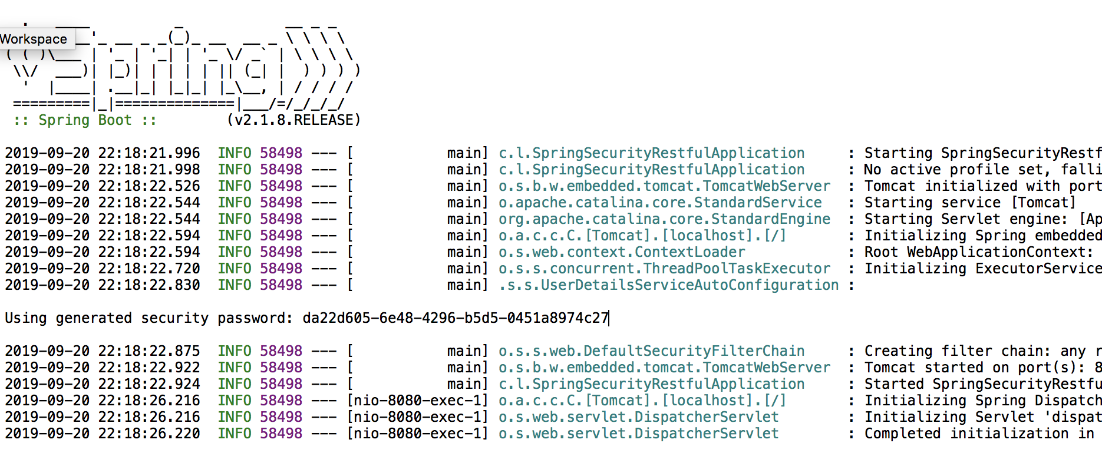
Start the server, observe the password
Default username:
user
Default password:
Auto generated, find from console

Slide 6
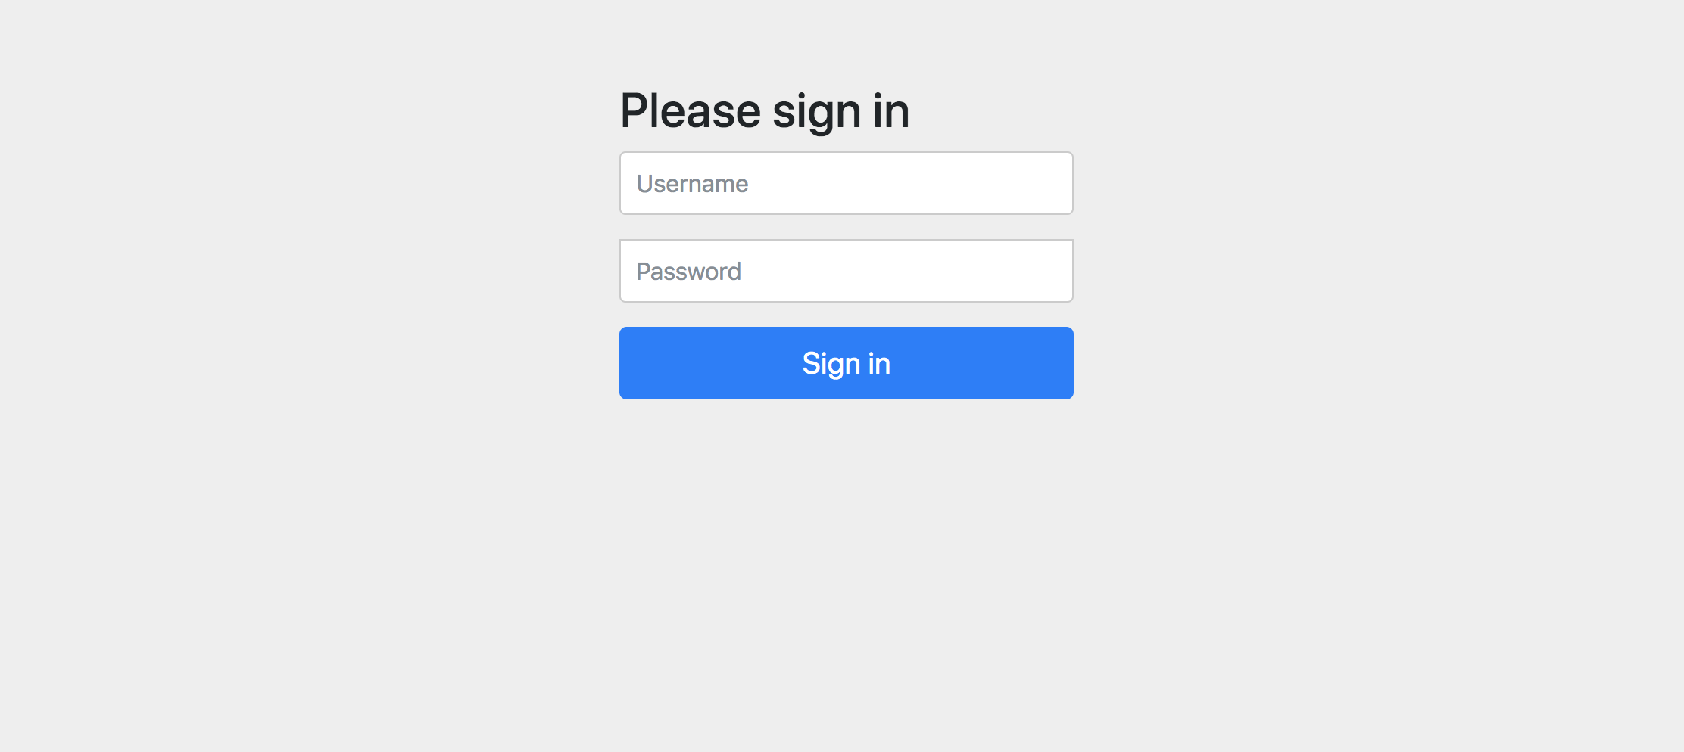
The login page – Auto created
Username: user
Password: as shown in console

Slide 7
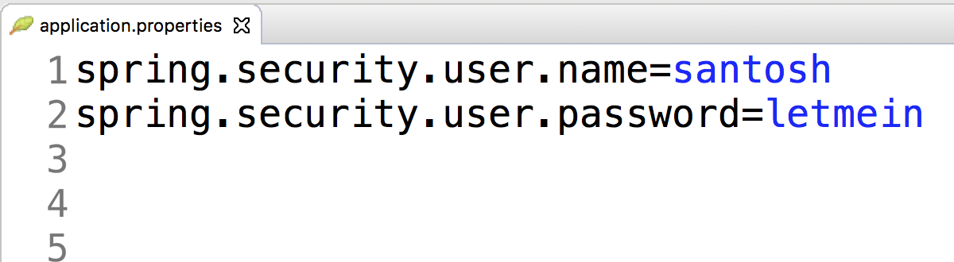
Configuring Spring Security Step-2: configure security username/password
Username: santosh
Password: letmein

Slide 8

Questions
Send to skkar.2k2@gmail.com

